Slide 1
Prediction of Google Stock Prices Using Neural Network
Stevens Institute of Technology
Financial Engineering Department
FE 590 Introduction to Knowledge Engineering
By: Talal Alsulaiman
Supervised By: Prof. Mahmoud Daneshmand

Slide 2
Presentation Outline
Introduction
Inputs and output variables
RSI
PROC and VROC
Data Preprocessing
Data Collection
Data Transformation
DATA Separation
Methodology
Neural Network
Models
Software Package
Validation
Criteria
Validate the models
Scoring
Testing
Conclusion

Slide 3
Introduction
Any Investment has to go through two main steps
First step begins with observation, predicting, and analysing securities and ends by making certain believe about future performance of these securities.
The second step starts with creation of trust about the future performance and ends with an allocation of a portfolio.
We are concern in this project with the first step.
The problems with the prediction are:
The conflict between Behavioural Finance and Efficient Market Hypothesis.
Even if we have opportunity to predict the market it is very to find it.
EMH:
All the information are reflected in the price and thus we can not predict the future.
BF:
information structure and the characteristics of market participants influence decisions and market outcomes.

Slide 4
Introduction
The objective of the project is to try to predict the future stock prices of Google Inc. using Neural Network.
The project flow chart is as following:
Define the input variables and target variable
Divide the data into training and testing sets
Set up the NNT parameters
Data Preprocessing
Is the error acceptable?
Validate the model based on evaluation criteria
Train the algorithm based on Training set
Deploy the model
Adjust the models parameters

Slide 5
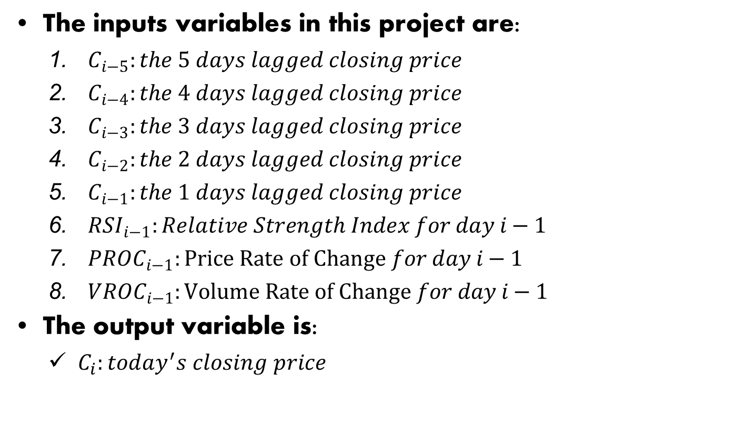
Inputs and output variables
The inputs variables in this project are:
$C_{i−5}:the 5 days lagged closing price$
$C_{i−4}:the 4 days lagged closing price$
$C_{i−3}:the 3 days lagged closing price$
$C_{i−2}:the 2 days lagged closing price$
$C_{i−1}:the 1 days lagged closing price$
$RSI_{i−1}:Relative Strength Index for day i−1$
$PROC_{i−1}:Price Rate of Change for day i−1$
$VROC_{i−1}:Volume Rate of Change for day i−1$
The output variable is:
$C_{i}:today^{′}s closing price$

Slide 6
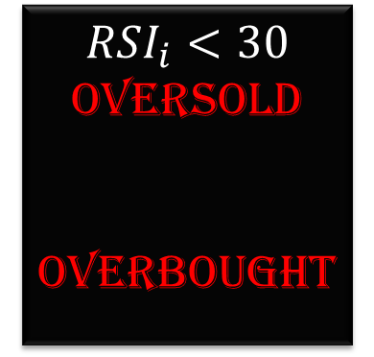
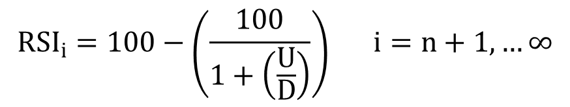

Inputs and output variables: RSI
A | B | C | D | E | F | G | H | I | J
Date | Close | UP | Down | Ave.Up | Ave.Down | E/F | 1+G | 100/H | 100-I
19-Aug-04 | 100.34
20-Aug-04 | 108.31 | 7.97 | 0
23-Aug-04 | 109.4 | 1.09 | 0
24-Aug-04 | 104.87 | 0 | 4.53
25-Aug-04 | 106 | 1.13 | 0
26-Aug-04 | 107.91 | 1.91 | 0
27-Aug-04 | 106.15 | 0 | 1.76
30-Aug-04 | 102.01 | 0 | 4.14
31-Aug-04 | 102.37 | 0.36 | 0
01-Sep-04 | 100.25 | 0 | 2.12
02-Sep-04 | 101.51 | 1.26 | 0
03-Sep-04 | 100.01 | 0 | 1.5
07-Sep-04 | 101.58 | 1.57 | 0
08-Sep-04 | 102.3 | 0.72 | 0
09-Sep-04 | 102.31 | 0.01 | 0 | 1.144286 | 1.0035714 | 1.140214 | 2.140214 | 46.72431 | 53.27569
10-Sep-04 | 105.33 | 3.02 | 0 | 0.790714 | 1.0035714 | 0.7879 | 1.7879 | 55.93153 | 44.06847
13-Sep-04 | 107.5 | 2.17 | 0 | 0.867857 | 1.0035714 | 0.864769 | 1.864769 | 53.62595 | 46.37405
$$RSI_{i}<30$$
Oversold
Overbought
$$RSI_{i}>70$$
$${RSI}_{i}=100−\left(\frac{100}{1+\left(\frac{U}{D}\right)}\right) i=n+1,…∞$$

Slide 7
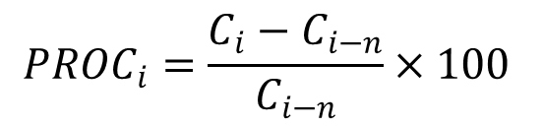
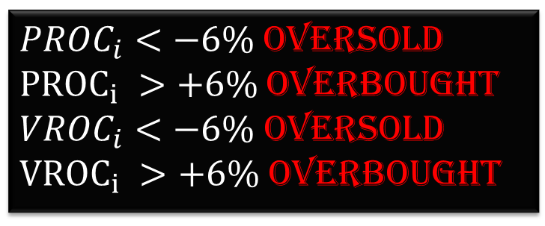
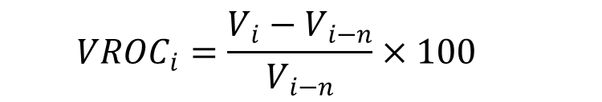
Inputs and output variables: PROC and VROC
Date | Close | Volume | PROC (12) | VROC (12)
19-Aug-04 | 100.34 | 22088000
20-Aug-04 | 108.31 | 11377000
23-Aug-04 | 109.4 | 9090700
24-Aug-04 | 104.87 | 7599100
25-Aug-04 | 106 | 4565900
26-Aug-04 | 107.91 | 3527900
27-Aug-04 | 106.15 | 3102400
30-Aug-04 | 102.01 | 2585600
31-Aug-04 | 102.37 | 2455900
01-Sep-04 | 100.25 | 4525000
02-Sep-04 | 101.51 | 7477500
03-Sep-04 | 100.01 | 2572600
07-Sep-04 | 101.58 | 2948400
08-Sep-04 | 102.3 | 2493900
09-Sep-04 | 102.31 | 2061500 | -0.06481 | -0.77323
10-Sep-04 | 105.33 | 4736800 | 0.004386 | -0.37666
13-Sep-04 | 107.5 | 3915300 | 0.014151 | -0.14249
14-Sep-04 | 111.49 | 5402900 | 0.033176 | 0.531478
${PROC}_{i}<−6\%$ Oversold ${PROC}_{i} >+6\%$Overbought ${VROC}_{i}<−6\%$ Oversold ${VROC}_{i} >+6\%$ Overbought
$${PROC}_{i}=\frac{C_{i}−C_{i−n}}{C_{i−n}}×100$$
$${VROC}_{i}=\frac{V_{i}−V_{i−n}}{V_{i−n}}×100$$

Slide 8
Data Preprocessing: Data Collection
The closing prices and volumes have been downloaded from Google Finance. The data have 2048 dates for the period from 8/19 2004 until 11/28/20012. Also, the RSI for 14 days periods, PROC and VROC for 12 days periods have been calculated.
No. | Date | Close | RSI | PROC (12) | VROC (12)
1 | 19-Aug-04 | 100.34
2 | 20-Aug-04 | 108.31
3 | 23-Aug-04 | 109.4
4 | 24-Aug-04 | 104.87
5 | 25-Aug-04 | 106
6 | 26-Aug-04 | 107.91
7 | 27-Aug-04 | 106.15
8 | 30-Aug-04 | 102.01
9 | 31-Aug-04 | 102.37
10 | 01-Sep-04 | 100.25
11 | 02-Sep-04 | 101.51
12 | 03-Sep-04 | 100.01
13 | 07-Sep-04 | 101.58
14 | 08-Sep-04 | 102.3
15 | 09-Sep-04 | 102.31 | 53.27569 | -0.06481 | -0.77323
16 | 10-Sep-04 | 105.33 | 48.716607 | 0.004386 | -0.37666
… | … | … | … | … | …
2047 | 27-Nov-12 | 670.71 | 79.46827 | 0.028239 | -0.03428
2048 | 28-Nov-12 | 683.67 | 83.25788 | 0.03113 | -0.02809

Slide 9
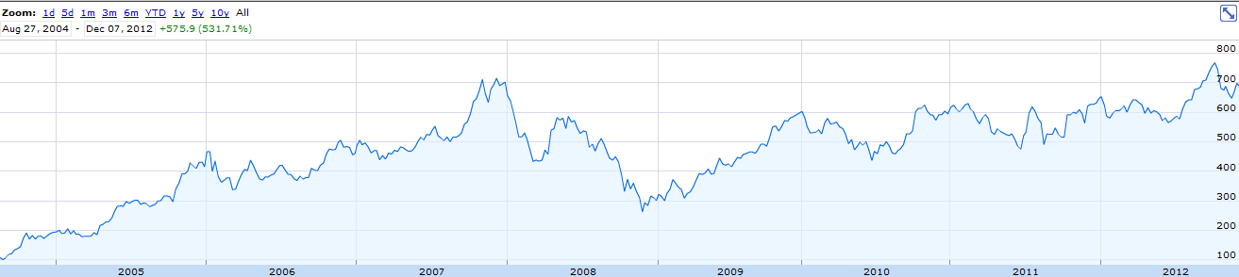
Data Preprocessing: Data Collection
http://www.google.com/finance?q=goog&ei=MH3EULjeEuHk0QHKXw

Slide 10
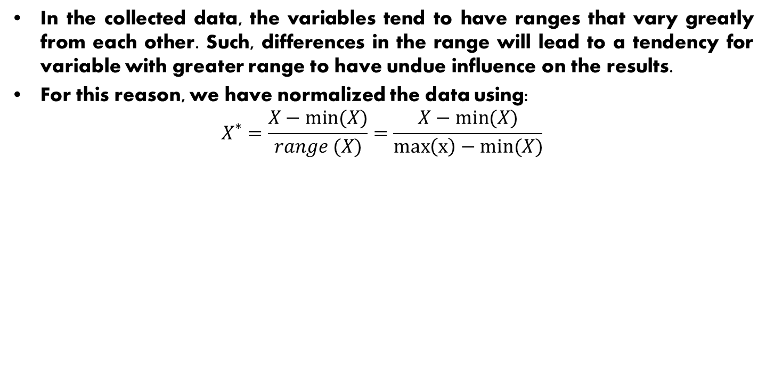
Data Preprocessing: Data transformation
In the collected data, the variables tend to have ranges that vary greatly from each other. Such, differences in the range will lead to a tendency for variable with greater range to have undue influence on the results.
For this reason, we have normalized the data using:
$$X^{∗}=\frac{X−min(X)}{range (X)}=\frac{X−min(X)}{\max\left(x\right)−min(X)}$$
No. | Date | Lagged 5 | Lagged 4 | Lagged 3 | Lagged 2 | Lagged 1 | Close | RSI (14) | PROC (12) | VROC (12)
1 | 09/09/2004 | 0 | 0.004536 | 0.007796 | 0.013789 | 0.014555 | 0.017514 | 0.589718 | 0.497152 | 0.181998
2 | 10/09/2004 | 0.004536 | 0.007796 | 0.013789 | 0.014555 | 0.017514 | 0.022802 | 0.590773 | 0.58598 | 0.191505
3 | 13/09/2004 | 0.007796 | 0.013789 | 0.014555 | 0.017514 | 0.022802 | 0.025611 | 0.695747 | 0.629521 | 0.198481
4 | 14/09/2004 | 0.013789 | 0.014555 | 0.017514 | 0.022802 | 0.025611 | 0.023327 | 0.860321 | 0.690887 | 0.120539
5 | 15/09/2004 | 0.014555 | 0.017514 | 0.022802 | 0.025611 | 0.023327 | 0.024139 | 0.799462 | 0.648351 | 0.040597
… | … | … | … | … | … | … | … | … | … | …
2025 | 14/11/2012 | 0.826509 | 0.818563 | 0.818443 | 0.850032 | 0.852675 | 0.846517 | 0.389574 | 0.38106 | 0.088736
2026 | 15/11/2012 | 0.818563 | 0.818443 | 0.850032 | 0.852675 | 0.846517 | 0.849671 | 0.318033 | 0.38259 | 0.134217
2027 | 16/11/2012 | 0.818443 | 0.850032 | 0.852675 | 0.846517 | 0.849671 | 0.839427 | 0.331055 | 0.389529 | 0.052169
2028 | 19/11/2012 | 0.850032 | 0.852675 | 0.846517 | 0.849671 | 0.839427 | 0.853787 | 0.322373 | 0.40557 | 0.099065
2029 | 20/11/2012 | 0.852675 | 0.846517 | 0.849671 | 0.839427 | 0.853787 | 0.873254 | 0.390875 | 0.458736 | 0.096493

Slide 11
Data Preprocessing: Data Separation
The data was divided into three parts:
70% for training :
1420 data points from 9/9/2004 until 5/6/2010 (1-1420)
15% for validation 1421-1724
304 data points from 5/7/2010 until 8/26/2011 (1421-1724)
15% for testing (this kept closed and not touched until final stage)
305 data points from 8/29/2011 until 11/20/20112 (1725-2029)

Slide 12
Methodology: Neural Network
A neural network, is a mathematical model inspired by biological neural networks.
A neural network consists of an interconnected group of artificial neurons, and it processes information using connected nodes.
In most cases a neural network is an adaptive systems that changes its structure during a learning phase.
Neural networks are used to model complex relationships between inputs and outputs or to find patterns in data.
The outputs of neural networks is continuous.
Neural networks attempts to minimize SSE.

Slide 13
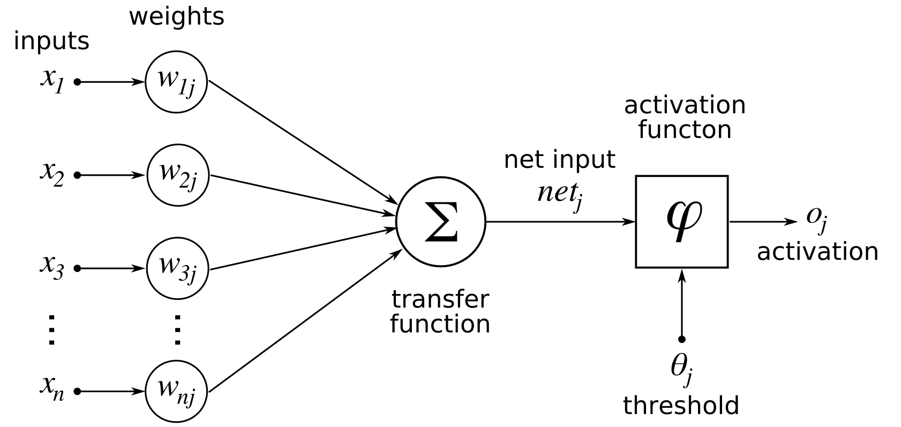
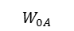
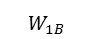
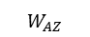
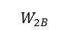
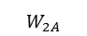

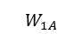
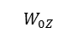
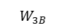
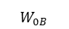
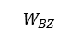
Methodology: Neural Network
Input Layer
Hidden Layer
Output Layer
Node 1
$$W_{1A}$$
$$W_{0A}$$
$$W_{1B}$$
Node A
$$W_{AZ}$$
$$W_{2A}$$
Node Z
Node 2
$$W_{2B}$$
Node B
$$W_{BZ}$$
$$W_{3A}$$
$$W_{0Z}$$
Node 3
$$W_{3B}$$
$$W_{0B}$$

Slide 14
Methodology: Models
In this Project we have developed six models:
In these models
Numbers of inputs are either 8 or 5.
There is only one hidden layers and its sizes are 3, 5 or 10.
There is only one output.
Model | Inputs | Size Hidden Layers | Output
1 | 8 | 3 | 1
2 | 8 | 5 | 1
3 | 8 | 10 | 1
4 | 5 | 3 | 1
5 | 5 | 5 | 1
6 | 5 | 10 | 1

Slide 15
Software Package
The used software is Rattle in R.
Rattle is Graphical User Interface for Data Mining in R.
R is a sophisticated statistical package. It provides most of the common and new approaches to data mining.
Reference for Rattle in R:
Data Mining with Rattle and R: The Art of Excavating
Data for Knowledge Discovery by Graham Williams
http://rattle.togaware.com/

Slide 16
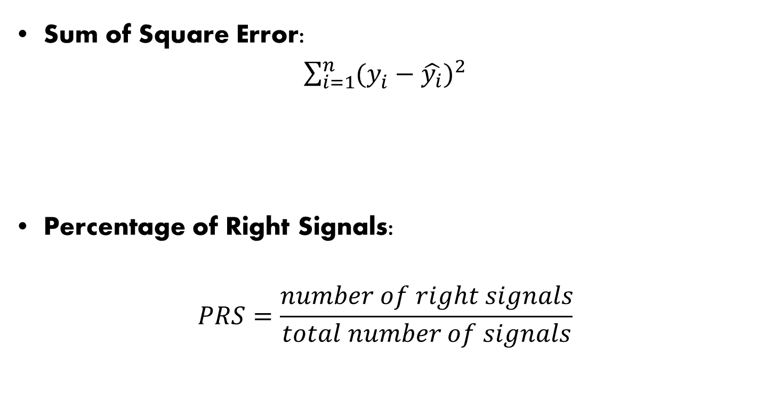
Validation: Criteria
Sum of Square Error:
$\sum_{i=1}^{n}{{(y_{i}^{}−\hat{y_{i}})}^{2}}$
Percentage of Right Signals:
$$PRS=\frac{number of right signals}{total number of signals}$$
May not be ideal for stock prediction

Slide 17
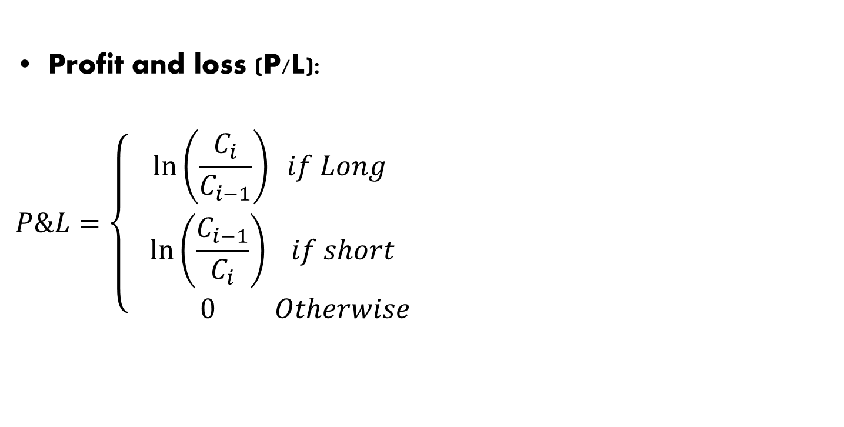
Validation: Criteria
Profit and loss (P/L):
$$P\&L=\left\{\begin{matrix}\ln\left(\frac{C_{i}}{C_{i−1}}\right) if Long \\ \begin{aligned} \ln\left(\frac{C_{i−1}}{C_{i}}\right) if short \\ 0 Otherwise\end{aligned}\end{matrix}\right.$$

Slide 18
Validation: Validate the models

Slide 19
Validation: Validate the models

Slide 20
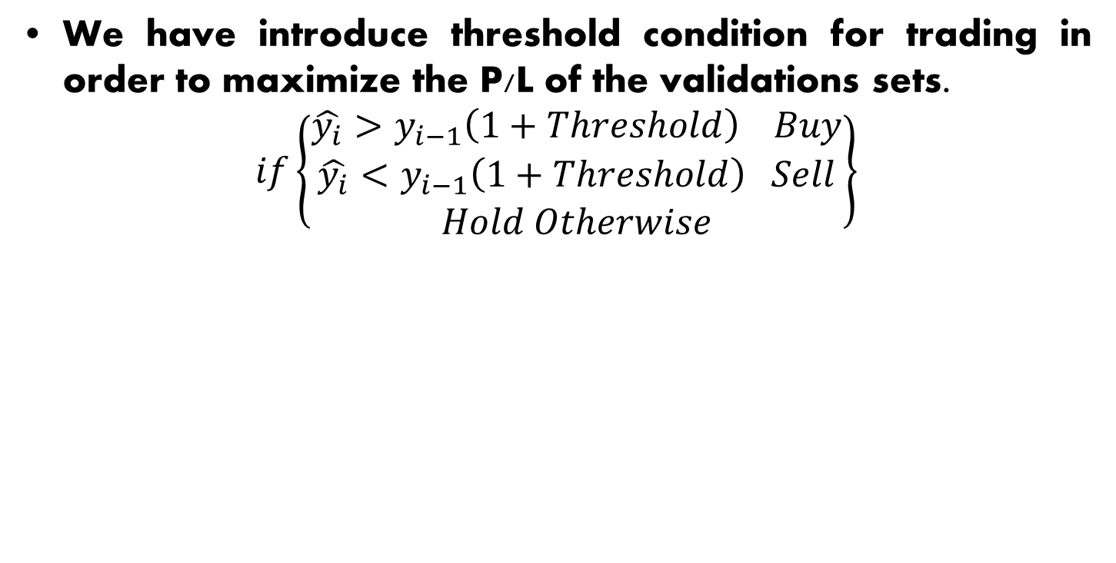
Validation: Validate the models
We have introduce threshold condition for trading in order to maximize the P/L of the validations sets.
$$if\left\{\begin{aligned}\begin{aligned}\hat{y_{i}}>y_{i−1}\left(1+Threshold\right) Buy \\ \hat{y_{i}}<y_{i−1}\left(1+Threshold\right) Sell\end{aligned} \\ Hold Otherwise\end{aligned}\right\}$$
Model 1 | Model 2 | Model 3 | Model 4 | Model 5 | Model 6
0.207% | 0.2% | 0.203% | 0.023% | 0.025% | 0.022%

Slide 21
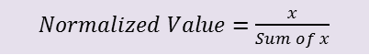
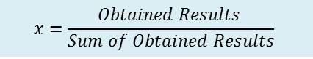
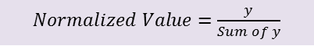

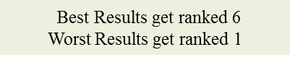
Validation: Scoring
 | Model 1 | Model 2 | Model 3 | Model 4 | Model 5 | Model 6 | SUM
SSE | 0.0771 | 0.0759 | 0.07573 | 0.0761 | 0.07621 | 0.0760 | 0.457266
% Right | 0.16331 | 0.16923 | 0.16804 | 0.16213 | 0.1633 | 0.1739 | 1
P/L | 40.22% | 40.64% | 67.54% | 82.54% | 59.53% | 68.24% | 3.587139
SSE | 16.87% | 16.61% | 16.56% | 16.65% | 16.67% | 16.63%
% Right | 35.72% | 37.01% | 36.75% | 35.46% | 35.72% | 38.04%
P/L | 87.96% | 88.88% | 147.7% | 180.5% | 130.1% | 149.2%
SUM | 140.55% | 142.50% | 201.0% | 232.6% | 182.5% | 203.9% | 1103.1%
Normalized Value | 12.7% | 12.9% | 18.2% | 21.1% | 16.5% | 18.5% | 100.0%
SSE | 1 | 5 | 6 | 3 | 2 | 4 | 21
% Right | 2.5 | 5 | 4 | 1 | 2.5 | 6 | 21
P/L | 1 | 2 | 4 | 6 | 3 | 5 | 21
SSE | 4.76% | 23.81% | 28.57% | 14.29% | 9.52% | 19.05%
% Right | 11.90% | 23.81% | 19.05% | 4.76% | 11.90% | 28.57%
P/L | 4.76% | 9.52% | 19.05% | 28.57% | 14.29% | 23.81%
SUM | 21.43% | 57.14% | 66.67% | 47.62% | 35.71% | 71.43% | 300.00%
Normalized Ranking | 7.14% | 19.05% | 22.22% | 15.87% | 11.90% | 23.81% | 100.0%
Obtained Results
$$x=\frac{Obtained Results }{Sum of Obtained Results}$$
$Normalized Value=\frac{x}{Sum of x}$
Best Results get ranked 6
Worst Results get ranked 1
y$=\frac{Obtained Ranking}{Sum of Obtained Ranking}$
$Normalized Value=\frac{y}{Sum of y}$
Final Score = Normalized Value * Normalized Ranking
Model 1 | Model 2 | Model 3 | Model 4 | Model 5 | Model 6
1.04% | 2.80% | 3.89% | 3.01% | 1.97% | 4.23%

Slide 22
Testing

Slide 23
Testing

Slide 24
Conclusion
Neural Network performs a good prediction by minimizing the SSE.
However, the problem that we face is the prediction of movement directions.
The addition of technical indicators (RSI,PROC, and VROC) have improved the prediction accuracy a little. Examining more indicators is recommended.
Introducing the threshold strategy did not improve the P/L
The P/L does not meet the required level, comparing with buy at 524.84 and sell at 683.67, the profit is less by 22%.
Rattle is a good software for the implementation of data mining techniques.

Slide 25
Thank you for your patient If you have any question please do not hesitate

